Slide 1

DF
LECTURE
NTFS Analysis
Diploma in CSF/IT
Year 2/3 (2022/23), Semester 4/6
Digital Forensics
6
Notes:
Left-hand Bar – Replace FSP by your module code and X by the lecture number.
Replace Lecture Title
Replace < Module Name >
Replace Year and Semester if necessary

Slide 2
Objectives
At the end of this, you will get to know more about:
NTFS Partition Boot Record (PBR)
NTFS Master File Table (MFT)
NTFS $Bitmap

Slide 3
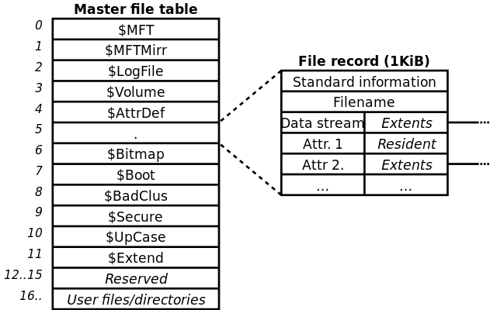
Eg. A Disk with 2 NTFS Partitions
MBR
PBR
MFT
Partition 0
PBR
MFT
Partition 1

Slide 4
Everything is a File in NTFS
Today, NTFS is the most common file system in use by all recent versions of Windows.
In NTFS, important data are allocated to files.
NTFS does not have specific layout like other file system, the entire file system is considered a data area, and any sector can be allocated to a file.
The only consistent layout is that the first sectors of the volume contain the boot sector and boot code.

Slide 5
Recap: NTFS File System
NTFS contains the following components:
Partition Boot Record (PBR) – similar to VBR in FAT
Master File Table (MFT) – similar to directory entry in FAT
$Bitmap – similar to FAT (FILE ALLOCATION TABLE)
Notes:
NTFS Physical Structure
The following information describes how clusters and sectors are organized on an NTFS volume, how the boot sector on the volume determines the file system, and how the Master File Table (MFT) organizes structures on the volume.
Clusters and Sectors on an NTFS Volume
A cluster (or allocation unit) is the smallest amount of disk space that can be allocated to hold a file. All file systems used by Windows Server 2003 organize hard disks based on cluster size, which is determined by the number of sectors (units of storage on a hard disk) that the cluster contains. For example, on a disk that uses 512-byte sectors, a 512-byte cluster contains one sector, whereas a 4-kilobyte (KB) cluster contains eight sectors.
Computers access certain sectors on a hard disk during startup to determine which operating system to start and where the partitions are located. The data stored on these sectors varies depending on the computer platform.
Sequence of Clusters on an NTFS Volume
Clusters on an NTFS volume are numbered sequentially from the beginning of the partition into logical cluster numbers. NTFS stores all objects in the file system using a record called the Master File Table (MFT), similar in structure to a database.
On NTFS volumes, clusters start at sector zero; therefore, every cluster is aligned on the cluster boundary. Contiguous clusters for file storage allow for faster processing of a file.
Limitations of Cluster Sizes on an NTFS Volume
Because NTFS uses different cluster sizes depending on the size of the volume, each file system has a maximum number of clusters it can support. The smaller the cluster size, the more efficiently a disk potentially stores information because unused space within a cluster cannot be used by other files. And the more clusters a file system supports, the larger the volumes you can create and format by using a particular file system. NTFS uses smaller cluster sizes, which makes it a more efficient file organization structure.
The table Default NTFS Cluster Sizes lists NTFS volume and default cluster sizes.
Default NTFS Cluster Sizes
Volume Size NTFS Cluster Size 7 megabytes (MB)–512 MB
512 bytes
513 MB–1,024 MB
1 KB
1,025 MB–2 GB
2 KB
2 GB–2 terabytes
4 KB
Maximum Sizes on an NTFS Volume
Before you format an NTFS volume, evaluate the types of files to be stored on the volume so that you can determine whether to use the default cluster size.
When formatting NTFS volumes, you can specify a cluster size of up to 64 KB using the Disk Management snap-in. If you format a volume, but do not specify a cluster size, default values are used. If you want to change the cluster size after the volume is formatted, you must reformat the volume.
Before you choose a cluster size other than the default, note the following important limitations:
For Microsoft Windows NT, Windows 2000, Windows XP, and Windows Server 2003, the cluster size of FAT16 volumes ranging from 2 gigabytes (GB) through 4 GB is 64 KB, which can create compatibility issues with some applications. For example, setup programs do not compute free space properly on a volume with 64-KB clusters and cannot run because of a perceived lack of free space. For this reason, you can use either NTFS or FAT32 to format volumes larger than 2 GB.
Because file compression is not supported on cluster sizes greater than 4 KB, the default NTFS cluster size for Windows Server 2003 never exceeds 4 KB.
In theory, the maximum NTFS volume size is 264 clusters minus 1 cluster. However, the maximum NTFS volume size as implemented in Windows Server 2003 is 232 clusters minus 1 cluster. For example, using 64-KB clusters, the maximum NTFS volume size is 256 terabytes minus 64 KB. Using the default cluster size of 4 KB, the maximum NTFS volume size is 16 terabytes minus 4 KB.
Note
If you use large numbers of files in an NTFS folder (300,000 or more), disable short-file name generation for better performance, and especially if the first six characters of the long file names are similar.
The table NTFS Size Limits lists NTFS size limits.
NTFS Size Limits
Description Limit Maximum file size
Architecturally: 16 exabytes minus 1 KB (264 bytes minus 1 KB)
Implementation: 16 terabytes minus 64 KB (244 bytes minus 64 KB)
Maximum volume size
Architecturally: 264 clusters minus 1 cluster
Implementation: 256 terabytes minus 64 KB ( 232 clusters minus 1 cluster)
Files per volume
4,294,967,295 (232 minus 1 file)
Partition Tables on MBR and GUID disks
Master boot record (MBR) disks use both basic and dynamic volumes. Because partition tables on MBR disks support partition sizes only up to 2 terabytes, you must use dynamic volumes to create NTFS volumes over 2 terabytes. Windows Server 2003 manages dynamic volumes in a special database instead of in the partition table; therefore dynamic volumes are not subject to the 2-terabyte physical limit imposed by the partition table. Dynamic NTFS volumes can be as large as the maximum volume size supported by NTFS. Itanium-based computers that use GUID partition table (GPT) disks also support NTFS volumes larger than 2 terabytes.
https://technet.microsoft.com/en-us/library/cc781134(v=ws.10).aspx

Slide 6
Partition Boot Record (PBR)
PBR is located at the first sector of an NTFS partition.
Byte Offset (in decimal) | Byte Offset (in hex) | Field Length (bytes) | Field Name
0 | 0 | 3 | Jump Instruction
3 | 3 | 8 | OEM ID
11-12 | 0x0B – 0C | 2 | Bytes per sector
13 | 0x0D | 1 | Sectors per Cluster
28-31 | 0x1C-1F | 4 | Hidden Sectors
40-47 | 0x28-2F | 8 | Total Sectors
48-55 | 0x30-37 | 8 | Logical cluster # for $MFT
56-63* | 0x38-3F | 8 | Logical cluster # for $MFT Mirr
* Windows XP and prior versions (see footnotes)
Notes:
Volume Boot Record
Windows XP and pior versions default to first sector beyond the first track on the disk, which equates to physical sector 63. Windows Vista, Windows7 as well as Windows 8 and 10 all default to physical sector 2048 for the start of the initial logical volume, to align with one megabyte boundaries. This change was necessary to properly address and align boundaries with newer hard disks with 4K sectors as well as solid state drives, which uses 4K memory pages.
https://superuser.com/questions/352572/why-does-the-partition-start-on-sector-2048-instead-of-63

Slide 7
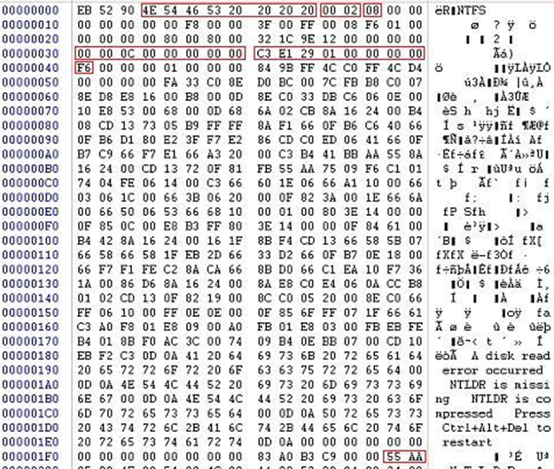
First Sector of NTFS Partition (PBR)
Jump instruction
OEM ID
Bytes/ sector
Sector/cluster
Logical cluster # for $MFT
Signature Word

Slide 8
MFT Concepts
MFT is the primary source of metadata in NTFS
It contains information about all files and directories, such as timestamps, size in bytes, attributes, parent directory, and content.
Every file and directory has an entry in MFT.
Each NTFS volume will contain its own MFT and it can be in any position on the volume.
To determine MFT’s starting location, we look at byte offset 48-55 in the boot record (PBR).
To start, we identify the Hex values for byte offset 48-55 in previous screenshot (slide 6).

Slide 9
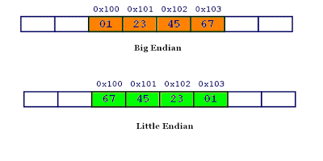
Data Representation - Endianness
Before we can proceed, let’s have a look at data representation in a typical file system.
In order to interpret data in a given format used, the order in which the information is stored and interpreted would need to be known, otherwise the result would be inaccurate.
Endianness of electronic data involves the ordering of fundamental units. It is the attribute of a system that indicates whether integers are represented from left or right or right to left.

Slide 10
Endianness
In computing, endianness comes in 2 flavors: Big endian and Little endian.
Big endian:
The most significant unit (or byte) is ordered first, or left justified.
E.g. for date, YYYY-MM-DD
Little endian:
The least significant unit (or byte) is ordered first, or right justified.
E.g. for date, DD-MM-YYYY

Slide 11
Endianness – cont.
More on Big and Little Endian
https://gerardnico.com/computer/memory/endian
Notes:
Big and Little Endian
Basic Memory Concepts
In order to understand the concept of big and little endian, you need to understand memory. Fortunately, we only need a very high level abstraction for memory. You don't need to know all the little details of how memory works. All you need to know about memory is that it's one large array. But one large array containing what? The array contains bytes. In computer organization, people don't use the term "index" to refer to the array locations. Instead, we use the term "address". "address" and "index" mean the same, so if you're getting confused, just think of "address" as "index".
Each address stores one element of the memory "array". Each element is typically one byte. There are some memory configurations where each address stores something besides a byte. For example, you might store a nybble or a bit. However, those are exceedingly rare, so for now, we make the broad assumption that all memory addresses store bytes.
I will sometimes say that memory is byte-addresseable. This is just a fancy way of saying that each address stores one byte. If I say memory is nybble-addressable, that means each memory address stores one nybble.
Storing Words in Memory
We've defined a word to mean 32 bits. This is the same as 4 bytes. Integers, single-precision floating point numbers, and MIPS instructions are all 32 bits long. How can we store these values into memory? After all, each memory address can store a single byte, not 4 bytes. The answer is simple. We split the 32 bit quantity into 4 bytes. For example, suppose we have a 32 bit quantity, written as 90AB12CD₁₆, which is hexadecimal. Since each hex digit is 4 bits, we need 8 hex digits to represent the 32 bit value.
So, the 4 bytes are: 90, AB, 12, CD where each byte requires 2 hex digits.
It turns out there are two ways to store this in memory.
http://www.cs.umd.edu/class/sum2003/cmsc311/Notes/Data/endian.html

Slide 12
MFT Concept – cont.
To convert to a recognisable hex form, there are two rules to be followed: the value of each byte is not changed, and the bytes are reordered from right to left.
For the Logical cluster number for $MFT:
Original (in big endian): 00 00 0C 00 00 00 00 00
Convert to little endian: 00 00 00 00 00 0C 00 00
Drop the leading zeros: 0C 00 00 (786,432 in decimal)
→ MFT will begin at Cluster Offset 786,432 in this example.
Note: In encase, data is presented in Big Endian

Slide 13
MFT Entry
MFT Entry Header
Attribute Headers
Attribute Content
Unused Space
MFT Entry
Offset 0x38: Start of attributes
1024 bytes
All MFT records follow the same structure. They are 1024 bytes in size.
At offset 0x38 (or 38 in hex) is the start of a string of attributes.
The header describes the properties of the record, and the attributes describe all aspects of the file from its name to its data.

Slide 14
MFT Entry – cont.
The essential elements of an MFT entry include:
Header:
Record Type – specify whether this entry is a file or directory
Record # - integer to identify a given MFT entry
Parent record # - record # of parent directory
Active/Inactive flag – Deleted files/directories are marked Inactive. NTFS will replace inactive entries with new active entries to prevent MFT from growing indefinitely
Attributes – contain metadata about a file/directory

Slide 15

MFT Entry – cont.
The first 4 bytes of the MFT are combined to form the identifier 'FILE'. If the entry is a folder, it will also be shown as 'FILE'.
If the entry is unusable the record identifier would be 'BAAD'.
No MFT record is ever removed from the MFT, they are reused. When a file or directory is deleted its record is flagged as deleted and is then available for re-use in future file or directory allocations.

Slide 16
NTFS System Files
The first 12 entries in MFT are used by system files that make NTFS work.
These files are all named with a $ and are hidden from view
To access any of these system files, you need to perform raw disk access using specialized forensic software tools such as EnCase.
https://commons.wikimedia.org/wiki/File:Ntfs_mft.svg
Notes:
NTFS System Files
NTFS includes several system files, all of which are hidden from view on the NTFS volume. A system file is one used by the file system to store its metadata and to implement the file system. System files are placed on the volume by the Format utility.
http://www.ntfs.com/ntfs-system-files.htm

Slide 17
NTFS System Files – cont.
MFT Record # | File Name | Description
0 | $MFT | Master File Table – A database that tracks every file in volume.
1 | $MFTMIRR | A backup copy of the first 4 records of MFT
2 | $LOGFILE | Transactional logging file
3 | $VOLUME | Contains volume name, NTFS serial number, etc.
4 | $ATTRDEF | NTFS attribute definition
5 | . | Root directory of the disk
6 | $BITMAP | Tracks the allocation of each cluster in the volume
7 | $BOOT | Boot record of the volume
8 | $BADCLUS | Used to mark defective clusters so NTFS will not attempt to use them
9 | $SECURE | Track security information for files within volume
10 | $UPCASE | Table of Unicode uppercase characters
11 | $EXTEND | Optional extensions

Slide 18
Change Logs
NTFS is a recoverable and journaled file system, so it maintains several logs designed to track changes to directories and files.
The data within these logs can be used to reverse file system operations in the event of a failure.
For FI, they can also serve as a useful source of evidence for file system activity, particularly in cases where an attacker has attempted to delete files and disguise their activity.

Slide 19
$Logfile
The NTFS log file, named $Logfile, tracks all transactions that change the structure of a volume.
That includes files or directory creation / copy / deletes, changes to metadata, and changes to INDX records.
Transaction entries within $Logfile contain the same attributes that are present in the MFT.
The log is circular and can roll over on a frequent basis, especially on system volumes.
Like $MFT and other artifacts, FI needs to use a forensic utility that provides disk access to copy $Logfile from the system.

Slide 20
NTFS Attributes
Each attribute is a varying-length stream identified by a 4-byte attribute type at offset 0x0.
The first attribute is usually type 0x00000010, $Standard_Information. Attributes are stored in ascending type order and terminated with the End marker 0xFFFFFFFF.

Slide 21
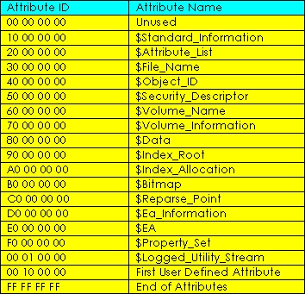
NTFS Attributes – cont.
The following is a list of attributes as defined in the $AttrDef system file:

Slide 22
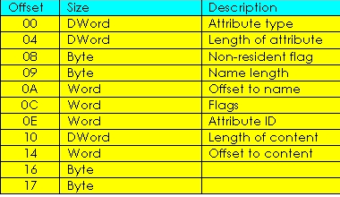
Attribute Header
MFT Entry Header
Attribute Headers
Attribute Content
Unused Space
MFT Entry

Slide 23
Typical File Record
File | Directory
$Standard_Information | $Standard_Information
$File_Name | $File_Name
$File_Name_(sometimes) | $File_Name_(sometimes)
$Data | $Index_Root
 | $Index_Allocation (sometimes)

Slide 24
Typical File Record – cont.
$Standard_Information and one $File_Name are mandatory for all files and directories.
If the filename is longer than 8 characters or contains special characters, Windows will also create a DOS compatible name and save this as a 2nd $File_Name attribute.

Slide 25
Typical File Record – cont.
For directories, their content is an index that lists all of their files.
The $Index_Root provides the header for the index. If there are only a few entries, they will fit in and be part of $Index_Root.
Once the listing is too long, an $Index_Allocation attribute is used to track which clusters on disk the index will reside.

Slide 26
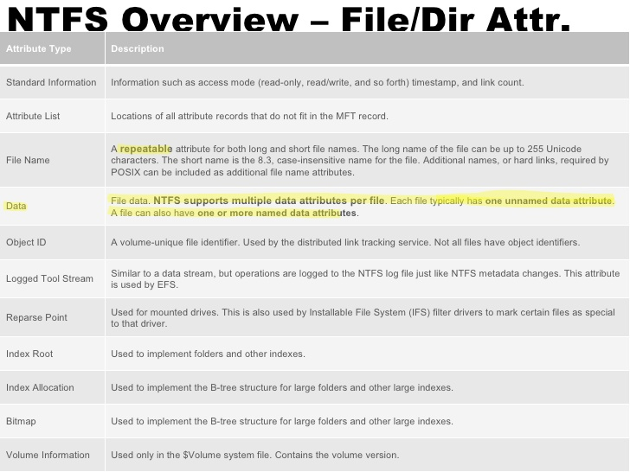
Typical File Record

Slide 27
Analyzing Timestamps
File timestamps are among the most important metadata stored in the MFT.
An MFT entry for a given file have at least 2 sets of attributes containing MACE (Modified, Accessed, Created, Entry Modified) timestamp attributes.
One set is contained within $Standard_Information ($SI) attribute, the other is contained in $File_Name ($FN) attribute.

Slide 28
MACE Timestamp
Definition of $SI MACE timestamps:
Modified When the contents of a file were last modified
Accessed When the contents of a file were last read
Created When the file was “born”
Entry Modified When the MFT entry associated with a file, rather then the contents of the file, was changed

Slide 29
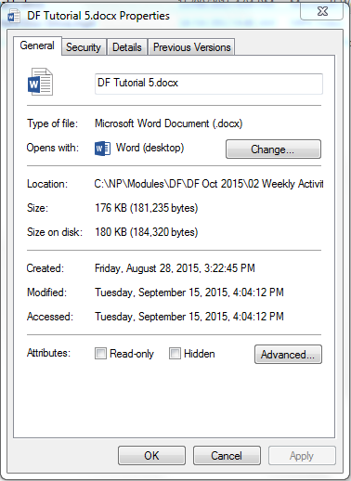
Windows Explorer Timestamps
File’s properties in Windows Explorer shows the $Standard_Information timestamps.
Note that it shows Modified, Accessed, Created, but not Entry Modified timestamp.

Slide 30
Resident and Non-Resident Attributes
MFT records may have attributes with a large content (such as a $Data attribute) such that all the attributes cannot be held within one base record.
In this case extension MFT records are used to hold some of the attributes.
The base MFT record is used for referencing the file, and the $Attribute_List attribute within it provides the references to all the extension records for the file.

Slide 31
Resident and Non-Resident Attributes – cont.
Attributes whose content is held entirely within the attribute (be it a base or extension MFT record) are known as Resident.
Attributes whose content is not held entirely within the attribute are known as Non-Resident.
At offset 0x08 (Non-resident flag), the bytes for
Resident attributes are set to 0,
Non-resident attributes are set to 1.

Slide 32
Resident and Non-Resident Attributes – cont.
The $Data attribute is most likely to be non-resident.
A file with a few hundred bytes of data may have that data held entirely in the $Data attribute: the attribute will be Resident.
A longer file will have its data held in external clusters: the $Data attribute will hold external cluster information and will therefore be Non-Resident.

Slide 33
$Bitmap
NTFS uses bitmaps for several purpose.
The system file $Bitmap holds the map of logical clusters in use and not in use. This is used for finding free space when a file is allocated.
Bitmap is also used as MFT record attribute $Bitmap, with an attribute ID of 0xB0. This is used for mapping MFT records in - and out - of use.
Any bit set to 1 indicates an in-use cluster or record.

Slide 34
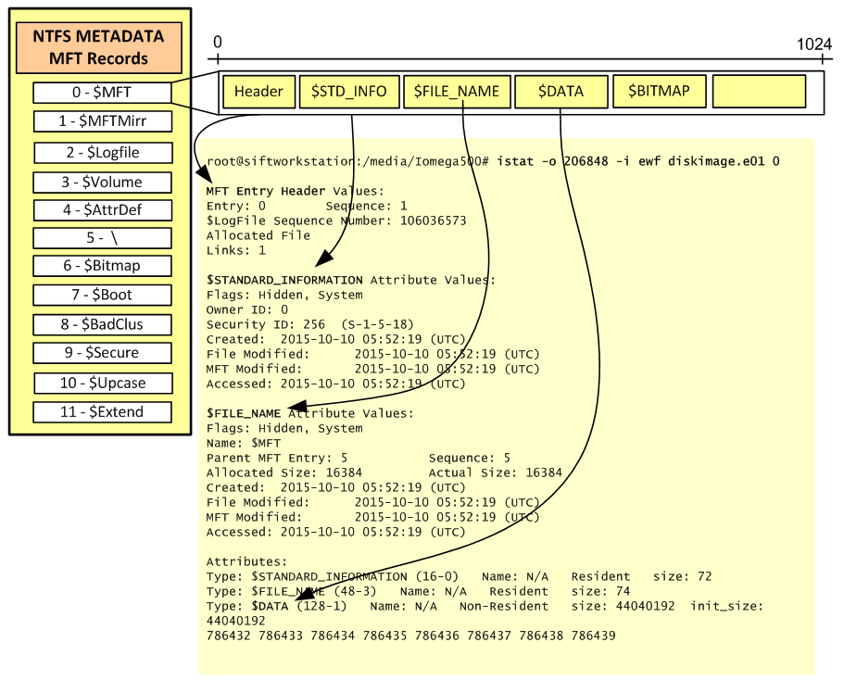
$Bitmap
Notes:
NTFS Master File Table
The Master File Table is a special system file that resides on the root of every NTFS partition. This file contains a wealth of forensic evidence. The file is named $MFT and is not accessible via user mode API’s but can been seen when you have raw access to the disk e.g, forensic image. This special file contains entries for every file and directory including itself. As written by Brian Carrier the MFT is the heart of NTFS. Each entry of the $MFT contains a series of attributes about a file, directory and indicates where it resides on the physical disk and if is active or inactive. The active/inactive attribute is the flag that tracks deleted files. If a file gets deleted, its MFT record becomes inactive and is ready for reuse. The size of these entries are usually 1Kb. Because each record doesn’t fill 1Kb each entry contains an attribute stating if contains resident data or not. Due to file system optimization, NTFS might store files directly on MFT records. A good example of this are Internet cookie files. Microsoft reserves the first 16 MFT entries for special metadata files. These entries point to a special file that begins with $. The $Bitmap and $LogFile are examples of such files. A list of the first MFT entries are shown in the below picture. As well, it shows how to read the MFT record of a disk image on SIFT workstation using istat. The 0 at the end of the command is the record number you want to read for this partition that starts at offset 206848. The record 0 is the $MFT file itself.
Each record contains a set of attributes. Some of the most important attributes in a MFT entry are the $STANDART_INFORMATION, $FILENAME and $DATA. The first two are rather important because among other things they contain the file time stamps. Each MFT entry for a given file or directory will contain 8 time stamps. 4 in the $STANDARD_INFORMATION and another 4 in the $FILENAME. These time stamps are known as MACE.
M – Modified : When the contents of a file were last changed.
A – Accessed : When the contents of a file were accessed/read.
C – Created : When the file was created.
E – Entry Modified : When the MFT record associated with the file changed.
https://countuponsecurity.com/2015/11/10/digital-forensics-ntfs-metadata-timeline-creation/

Slide 35

$Boot file (VBR)
The 16 sectors (two clusters) at logical sector zero in the active partition, containing the VBR and the bootstrap code, are defined in NTFS as the $Boot file.

Slide 36
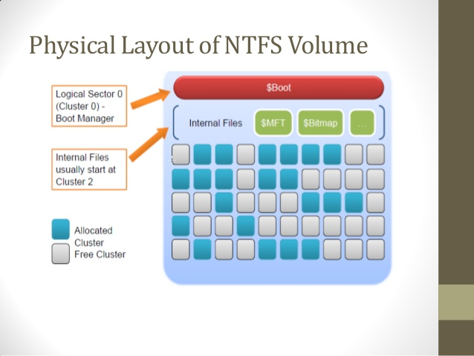
$Boot file (VBR)

Slide 37
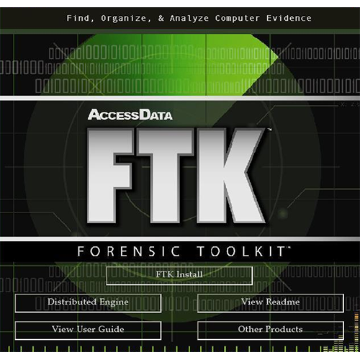
MFT Analysis Tools
Most commercial tools including EnCase and FTK are capable of extracting and parsing the content of $MFT and other NTFS structures.
Many free and open source software are also available to analyze such evidence:
The Sleuth Kit (www.sleuthkit.org/sleuthkit)
Mft2csv (code.google.com/p/mft2csv)
analyzeMFT (github.com/dkovar/analyzeMFT)
Plaso (plaso.kiddaland.net)
Notes:
http://accessdata.com/products-services/forensic-toolkit-ftk

Slide 38
Summary
Everything is a file in NTFS, including MFT and boot record.
Basic components of NTFS:
Partition Boot Record (PBR)
Master File Table (MFT)
$Bitmap
MFT can be in any position on the disk.
$Bitmap is used to track the use of the cluster of MFT record.

Slide 39
Reference Books
Brian Carrier, (2005). File System Forensic Analysis. Addison-Wesley, Pearson Education.
Albert J. Marcella, Jr. Frederic Guillossou (2012). Cyber Forensics – From Data to Digital Evidence. Wiley Corporate F&A.
DF210: Building An Investigation with Encase Forensics. Guidance Software (2017)
Notes:
Publisher: Cisco Press, Thomson Learning

